Slide 1
Volunteer Orientation 2018
New Volunteer Orientation – 2018

Slide 2
Orientation Objectives
Learn about Inspiring Minds: who we are, our goals, and what we do and how we do it.
Understand our students, the challenges they face and our opportunity.
Become familiar with the basics of literacy, math and problem solving as a tutoring strategy
Become familiar with developmental relationships and why they’re important
Know what to do on your first day and beyond.

Slide 3
Established in 1963 to address education inequalities during desegregation
We’ve grown: Lippitt Hill Tutorial, Mt. Pleasant Tutorial and Volunteers In Providence Schools (VIPS)
Continuously change to meet the needs of the community

Slide 4
Mission:
Inspiring Minds’ mission is to create successful students by providing them with the appropriate academic and social supports.
Notes:
Who

Slide 5
Inspiring Minds’ Funding
Inspiring Minds funds its programs and services through:
Direct and Indirect contributions (17%),
This includes corporate matching gifts, SECA and United Way Payroll Designation.
Grants (70%),
Events (13%).
Neither Providence Public Schools nor the City of Providence contribute to our annual budget.
Our major grantors include the Carter Foundation, the Routhier Foundation, the Elms Foundation, the Murray Family Foundation, and the Collis Foundation.

Slide 6
About Our Students

Slide 7
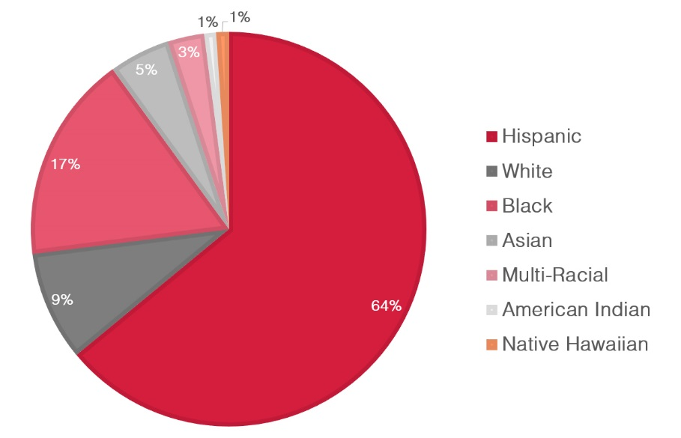
Students by Race
2016-2017 PROVIDENCE PUBLIC SCHOOL STUDENTS
Providence Public Schools Brief Overview. Rep. Providence Public Schools Department, 14 Mar. 2014. Web. 19 Aug. 2014. <http://www.providenceschools.org/files/_ySFDs_/96c80521742540473745a49013852ec4/Brief_Overview_031414.pdf>.

Slide 8
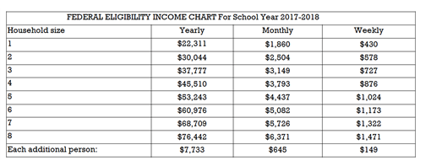
Family Income – Providence Students

Slide 9
Providence by the numbers
RI Kidscount Factbook, 2017 | Providence | Urban Core | Remainder of the State
Children living in poverty (Census, 2000) | 41% | 36% | 7%
English Language Learners | 22% | 18% | 20%
Receiving Special Education Services | 15% | 16% | 14%
Mobility Rate | 24% | 23% | 10%
Are Chronically Absent in the early years | 21% | 19% | 7%
Read Proficiently at 3rd Grade | 23% | 24% | 47%
Meet Math Expectations at 7th grade | 10% | 10% | 36%
Graduate from High School in 4 years | 79% | 78% | 89%
Go on to college | 46% | 44% | 59%
Of those who go on to college, enrolled in 3rd semester | 30% | 29% | 46%

Slide 10
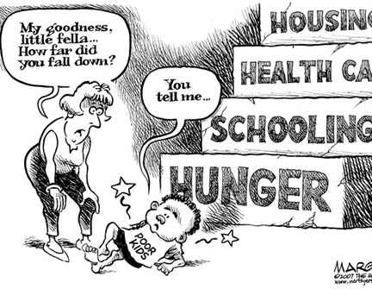
Why Does It Matter?
Income is strongly correlated with children’s cognitive, language, & literacy skills at school entry.
In addition to poverty, key influences on school readiness include preschool attendance, parenting behaviors, parents’ education, maternal depression, prenatal exposure to tobacco, and low birth weight.
Poor children without access to a high-quality early childhood experience children enter school 1½ to 2 years behind and, often, with vocabularies one-third the size of their more affluent peers.
Notes:
Brookings Institute, 2012

Slide 11
Inspiring Minds’ Programs
In-School Tutoring and Mentoring: Volunteers are matched with students in small groups to develop a trusting, mutually satisfying relationship and to engage in structured activities, often around classroom- or homework-related topic.
Power Lunch: Our corporate program where businesses partner with a school to read and mentor children during their elementary school years.
Kindergarten Project: 2 college students and one community volunteer, 4 days per week, 2 hours a day, to support literacy stations.
KidsBridge: Our summer learning program for students entering Kindergarteners; focuses on school norms and classroom routines.
Breakfast Buddies: Partners individuals and groups with Kindergarteners to support their morning routine.

Slide 12
Our goals…
Our goal is to promote equity and access to all students to meet grade-level standards for the purpose of becoming college and career ready. Our vision aligns our work directly with the district’s strategic plan to offer a high-quality, personalized learning experience for the students engaged in our program.
Inspiring Minds measures outcomes for students, volunteers, and the district. We do this through
Student Data: STAR BOY, EOY test scores in literacy and math, BIMAS Scores, Developmental Asset Profile
Volunteers: Surveys, Impact statements
District: Surveys, Impact statements related to school culture and climate.
Notes:
See handout on program goals for the specific goals for each program.

Slide 13
How Inspiring Minds works:
We connect trained volunteers to struggling students to develop close connections through which young people discover who they are, gain skills to shape their own lives, and learn how to interact and contribute to the world around them.

Slide 14
Consider tutoring and mentoring as complementary in your work with students.
Tutoring is the direct and clearly defined work to support the students’ academic skill development.
Mentoring is the more indirect work aimed at to instilling positive academic attitudes which will promote academic achievement.

Slide 15
About Public Schools:
Teachers teach to standards:
Early Learning and Development Standards
Common Core State Standards
English Language Arts
Math
Next Generation Science Standards
Social and Emotional Learning Standards

Slide 16
About Teaching to Standards
Standards are expectations for what children should know and be able to do.
1
Standards are not curriculum.
2
Schools often adopt a curriculum that is “common core aligned” – Lexia, Reading Street, Eureka Math or create a curriculum that is aligned.
3

Slide 17
About the Common Core
https://vimeo.com/116379560

Slide 18
Notes:
Phonemic Awareness: The ability to hear, identify, and say the individual sounds in spoken words
Phonics: The ability to connect the sounds of language with written letter
Fluency: The ability to read accurately, quickly and with expression
Vocabulary: The ability to properly say and know the meaning
of words
Comprehension: Understanding and being able to take meaning
from text
Sign up for Deep Dive Literacy to learn more!

Slide 19
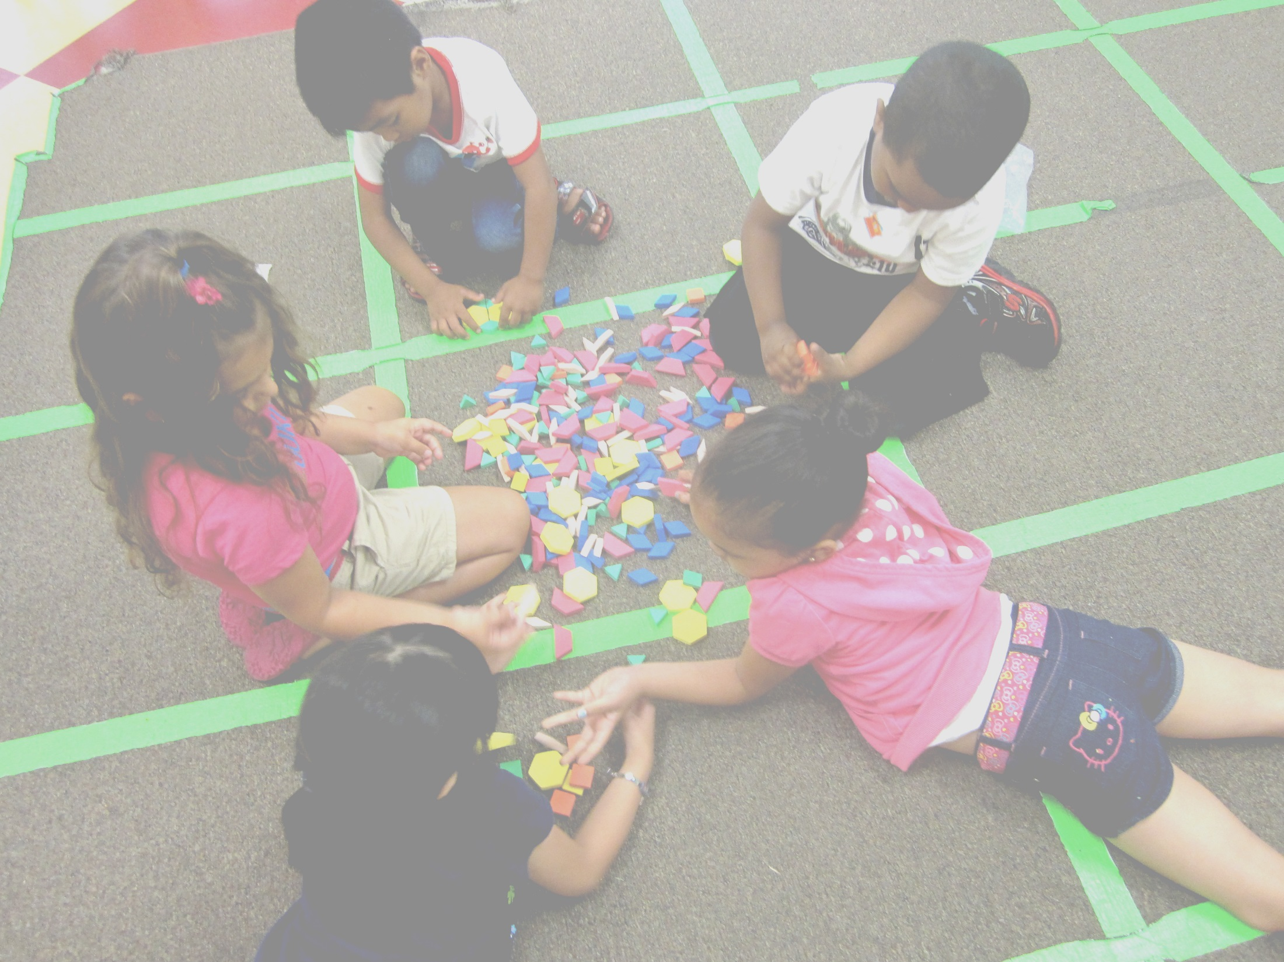
WHAT TO KNOW: MATH

Slide 21
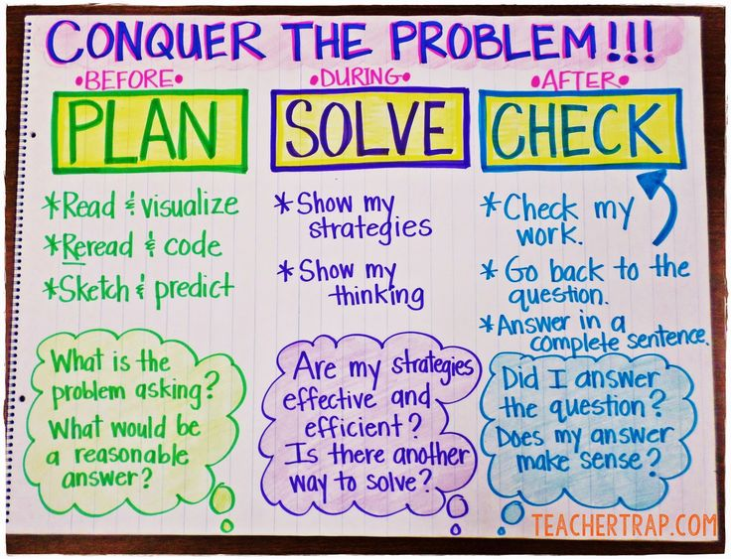
Notes:
Sign up for Deep Dive: Math to learn more!

Slide 22
What do we say while children are working?
Tell me about what you’re doing.
What is your plan?
What’s your next step?
What materials will you need?
Were you inspired by someone else?
How will you represent that?
Why did you choose….?
Are you satisfied with how’s it’s going?
What help do you need?
What are you proud of?
How can you work together? How will you decide who will do what part?
What should the conversation be here?
How can you help each other?
What else could you try?
Did you ask a friend for feedback?
How will you document this?
What are we thinking?
What do you think?
Why don’t you try that?
What does this represent?

Slide 23
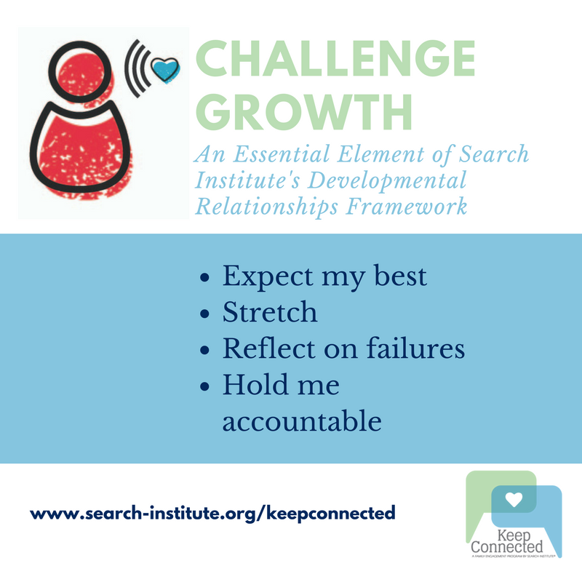
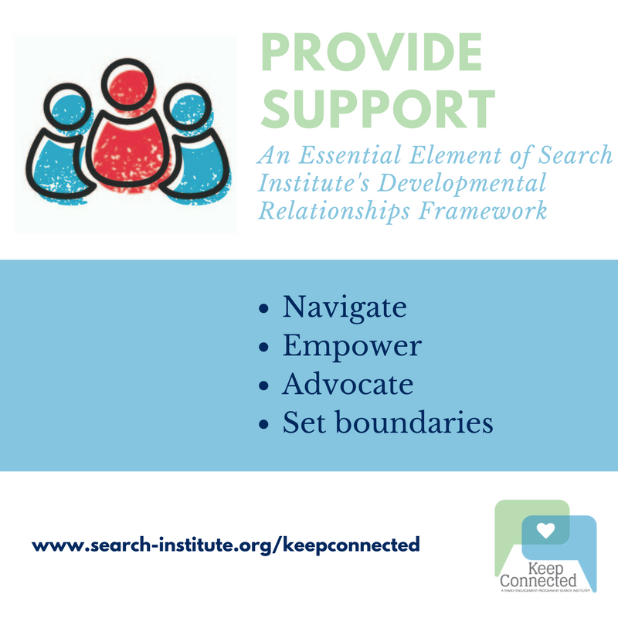
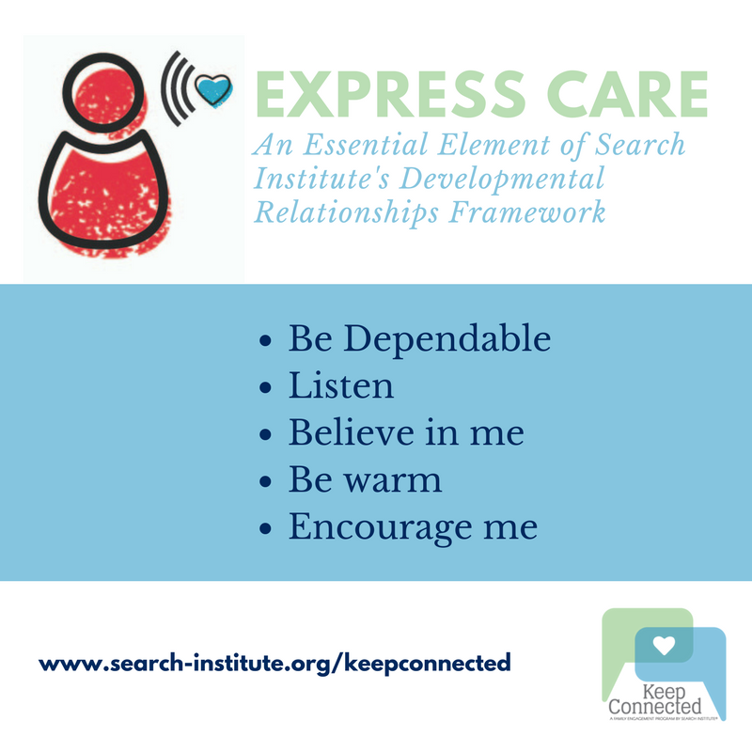
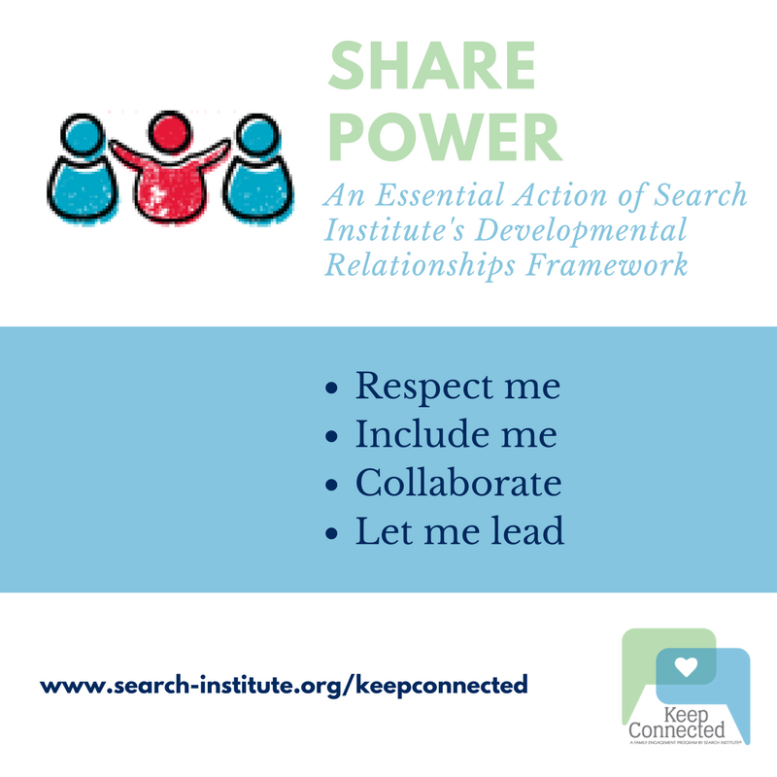
Developmental Relationships Framework
Notes:
Sign Up for Everyday Mentoring to learn more!

Slide 24
The bottom line:
The bottom line:
Relationships Matter

Slide 25
Volunteer Policies and Protocols

Slide 26
Preparing for emergency situations
Each school and each classroom has an emergency procedure
Follow the teacher’s lead
Help move children to the appropriate area

Slide 27
Confidentiality
Do not discuss personally identifiable student information outside of the program
Posting on the wall. Please use student initials if you want to talk about a specific student.
DB is making great progress on his fractions. We spent our hour making pizzas and dividing up the slices to make sure we had enough for the guests at our party”.

Slide 28
Code of conduct
Inspiring Minds defers to the Providence School’s Code of Conduct for Students
Personal contact outside of school is not permitted.
Absolutely no food, candy or special gifts to children
If you want to plan something special (holiday gifts, school supplies) just talk to us and we’ll get consent from the school.
Keep your personal items out of reach of children.
Drug and or alcohol use prohibited prior to or during school events.

Slide 29
Follow the dress code
✓
x

Slide 30
Mandatory reporting
It’s the law!
Listen to understand.
Thank them for telling you.
Tell children you have to tell someone if someone is getting hurt.
Do not ask follow up questions.
Immediately tell the principal and call Inspiring Minds’ Immediately
Document
We’ll help you report it.

Slide 31
Agreements
Providence Public School’s protocol for reporting known or suspected child abuse
Mandatory Reporting Form
Need a copy of your photo ID before you leave
Volunteer Agreement
Consent for Background Check
Get a BCI- Not Fingerprints!
Please let us take your photo for your photo ID.

Slide 32
Day One and Beyond

Slide 33
Getting to School and your classroom
Every school is different. Follow the instructions on your school fact sheet.
Clerks have tough jobs. Love them.
Arrive 15-20 minutes early.
Parking can be challenging!
You will want to avoid parking in the school’s parking lots; many of the faculty double park and you may get blocked.
Use intercom box at main entrance and identify yourself as an Inspiring Minds volunteer
Sign in at the main office and collect your ID Badge

Slide 34
Day One in the classroom
Is observation!
Look around for:
Classroom expectations
Emergency protocols
Begin to build relationships with your students
Learn how to pronounce your student’s names accurately
Get to know each other
Keep it friendly but professional
Get on their eye-level

Slide 35
Session 2: Implement the Developmental Asset Profile Survey
If you are placed with a student, grade 3 and up, you will be provided with the DAP and implementation tips before your second visit.
It’s expected to take no more than 15 minutes.
During the second visit:
Explain the survey- Follow the script.
Provide the student with the survey
You can read the questions to the child if their reading skills are not strong.
If they don’t understand the question, you can explain it to them.
If they don’t finish, that’s ok. You can finish on the third visit.
Collect the survey and place it in a sealed envelope and put that envelope in the manila envelope labeled DAP (found in the Inspiring Minds Binder).
You’ll implement again after the student has a minimum of 20 impacts.

Slide 36
Give Pulse
Why GIvePulse?
Increase Inspiring Minds’ ability understand what’s happening on the ground and follow up.
Increase our communication with volunteers.
Allows for transparency with the school.
What you can do:
Register for events
Tell us you are unable to attend a shift
Rate and comment on your experience
Ask for help
Message us
Connect with other volunteers on the “wall”

Slide 37
GivePulse User Resources
On our website: Volunteer-Volunteer Resources (coming soon)
On GivePulse
User Guide
How Do I’s
Short instructional videos on key topics on our Facebook and web (soon).
Register for an event
Cancel a shift
Upload a document
Notes:
Sign up for GivePulse Help Session to learn more.

Slide 38
Opportunities for additional training, more opportunities to connect with each other, and access to more resources
Monthly newsletter with tips and stories via GivePulse
Communicate with other volunteers at your school via GivePulse
Deep dives will be offered monthly in Literacy and Math, pick one that’s convenient for you
Monthly “coffee hour” to meet face to face and discuss important topics
Help sessions for GivePulse
At least quarterly training opportunities
November: Providence Public School’s Strategic Plan
December: Everyday Mentoring
New resource page on our website
www.inspiringmindsri.org/volunteerresources
Overview of standards and curriculum
Activities to help you understand the learning goals and that you can do with students
“How do I’s” and short videos on GivePulse

Slide 39
BCIs
BCIs must be conducted annually. They expire 1 year after date of issuance.
In Person: BCI office moved! It’s now at the Pastore Complex in Cranston.
By Mail: Have the forms notarized and mail them with your check or money order.
Some local police departments will process a BCI.
By Inspiring Minds; we will process it here for you for $10.
You will need to maintain your BCI while you volunteer with us.
Simply upload your BCI into GivePulse.

Slide 40
Photo IDs
We need to have a copy of your government-issued or student ID issued by an Institute of Higher Education.
We’ll take your picture today. That photo will be on your ID card.
Your Inspiring Minds Photo ID must be worn during your shift. You’ll still be expected to provide collateral and return it at the end of your visit.

Slide 41
Other ways you can help!
That’s ok! If you’re unable to give your time, but want to help in another way, please consider these:
Subscribe to our email to keep in touch.
Refer a friend. Applications are available on our website.
Recommend a corporate partner.
Follow us on social media. Facebook, Instagram and Twitter. Following, commenting or liking our posts helps to increase our reach.
Making a financial gift. Every little bit helps.

Slide 42
Congratulations on completing your orientation!
Please have your photo taken for your ID
Please record your impact in GivePulse and complete the orientation survey.
What happens next:
To be placed, you must have a complete profile. Check “required information”.
Your BCI must be uploaded to your Give Pulse account.
$10.00 fee payable to Inspiring Minds or
Go to the Attorney General’s office to complete and upload.
Some local police departments also conduct BCI’s.
Then:
We complete reference checks
We complete the national sex offender registry check
You’ll get an email from us to register for an event. Confirm your placement.

Slide 43
Thank you!
Melissa Emidy
Executive Director
401-274-3240 Office
401-480-8415 Cell
Jane Lavoie
Director of Volunteers
401-274-3240

